Slide 1
Final Project: Comparison of CNN Models in Image Classification
Presented by Pengxu Zheng (s2917211)

Slide 2
Introduction
Image classification on multiple CNN models
Still in Progress
Originally, the plan was ambitious
- Train & valid big models on industrial standard datasets
- learned it the hard way that it needs more skills, $, and time than I had
Took a lot of unsuccessful approaches
Challenges, failures, frustrations…but it’s eventually back on track
New topic and a simpler approach
Notes:
Image Link: https://www.topbots.com/neurips-2020-vision-research-papers/

Slide 3
What happened…
Attempted the Train + Validation approach, but later found training and validation both take way too long on CPUs
No Nvidia GPUs, No CUDA…. even on the titan cluster (it could have been 500x faster if had one)
Data structure issues (Segmentation Faults everywhere...)
Datasets caveats
- Mainstream datasets are hard to use and configure (even to acquire, like ImageNet)
- Preprocessing needed in MSCOCO, multiple labels in the same image
- CIFAR-10 (32 x 32 images) is somehow not compatible with a lot of darknet models
- Different formats of labeling take too long to configure and troubleshoot
New frameworks such as Caffe were also attempted but were found more complicated than darknet
Notes:
Image Link: https://www.topbots.com/neurips-2020-vision-research-papers/

Slide 4

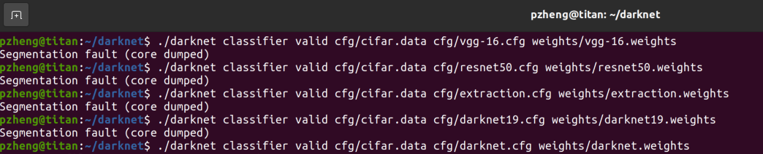
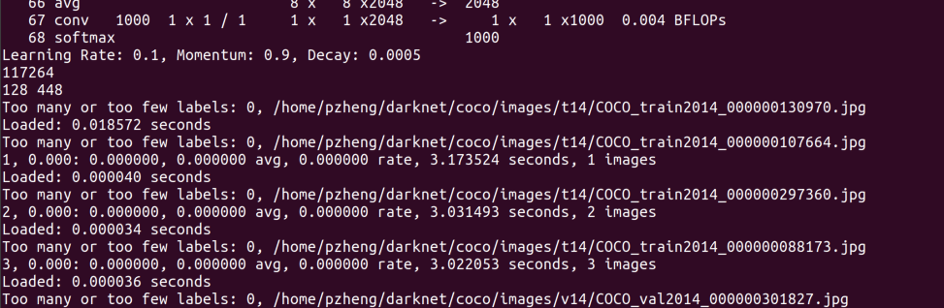
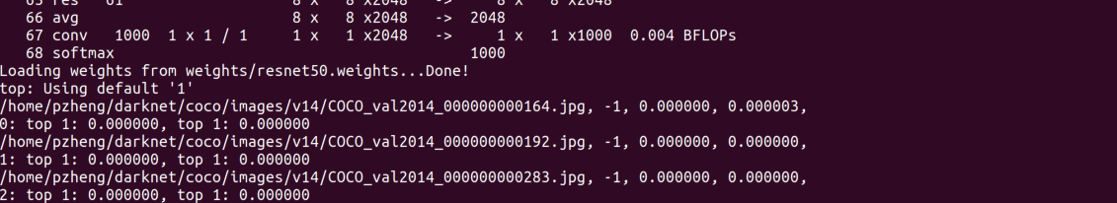
Snippets of depression and misery
Notes:
Image Link: https://www.topbots.com/neurips-2020-vision-research-papers/

Slide 5
The Compromise… a new direction
Extension of Homework 3 – VGG vs. ResNet using darknet
But more CNN models are selected
Customized dataset
2 major Comparison metrics:
- Top-1 and Top-5 (accuracy)
- Running time (speed)
Models were pre-trained using the HW3 setup with darknet
Notes:
Image Link: https://www.topbots.com/neurips-2020-vision-research-papers/

Slide 6
Models for Comparison
All Models were acquired from the darknet framework
Models were pre-trained, with .cfg and .weight files downloaded
The selection of models was made on a preference for the SOTA CNNs
Models of selection:
- VGG-16
- ResNet50
- DenseNet201 (from paper “Densely Connected Convolutional Networks” by
Huang et al, 2016)
- Extraction (variation of GoogleNet (Szegedy et al, 2014) by the author of darknet)
- Darknet Reference Model, the baseline for this comparison
Training from scratch was attempted but was not successful
Notes:
Image Link: https://www.topbots.com/neurips-2020-vision-research-papers/

Slide 7
Dataset Customization
In HW3, we have 3 groups of 20 medium-sized images
In this assignment, 5 groups are chosen
All images acquired from Google images that are of open access
Image selection rule:
- Varied degrees of realism (i.e. from animation or video game screenshots to real-world photography)
- Not being so easily recognizable (i.e. highly blurred background, a single and standard-shaped object with no background, etc)
- Representativeness (i.e. various angles, colors, positions, etc)
Notes:
Image Link: https://www.topbots.com/neurips-2020-vision-research-papers/

Slide 8
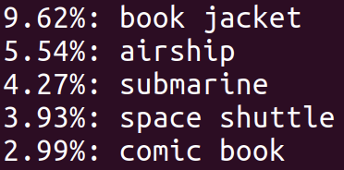
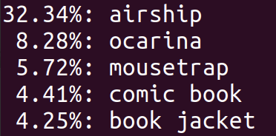

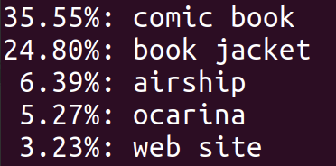
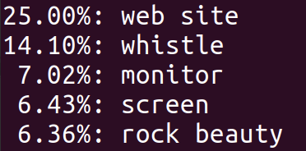
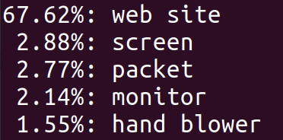
Preliminary Results (Top-5 Accuracy)
Actual Image
VGG-16, 3.88s
ResNet50, 0.88s
DenseNet201, 1.14s
Extraction, 0.70s
Darknet19, 0.66s
Notes:
Image Link: https://www.topbots.com/neurips-2020-vision-research-papers/

Slide 9
Result Interpretation – Accuracy per Class
Models | Class 1 | Class 2 | Class 3 | Class 4 | Class 5 | Avg. Score
VGG-16
ResNet50
DenseNet201
Extraction
Darknet Reference
Notes:
Image Link: https://www.topbots.com/neurips-2020-vision-research-papers/

Slide 10
Further Extension – Noise Resilience
For each image, automatically add random noise using some Python scripts (https://gist.github.com/Prasad9/28f6a2df8e8d463c6ddd040f4f6a028a)
Re-run with the chosen models and record accuracies
Compare with the results from the original images to see how the models perform against noise interferences
Notes:
Image Link: https://www.topbots.com/neurips-2020-vision-research-papers/

Slide 11
Conclusion
Extended HW3 to compare 5 CNNs with 5 classes of objects
Customized dataset with varying degrees of realism
A lot of trials and errors – progress was slow but it’s now on the right track
Further extensions
A lot of thanks to Dr. Lew for his insights and suggestions
Notes:
Image Link: https://www.topbots.com/neurips-2020-vision-research-papers/

Slide 12
Thank you!

